Slide 1



Color Correction for Optical See-Through Displays Using Display Color Profiles
Srikanth Kirshnamachari Sridharan
Dr. Juan David Hincapié-Ramos
Dr. David R. Flatla (University of Dundee)
Dr. Pourang Irani
Notes:
A very good afternoon.
My name is Srikanth Kirhsnamachari Sridharan,
I am a Masters student at Hci lab in university of Manitoba Canada.
The work I am going to present today is major part of my masters thesis

Slide 2
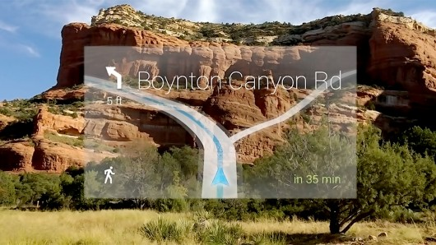
Introduction
Optical see-through displays (OSTD) allow users to view digital content and physical objects simultaneously. Additive OSTD have its own light source
Notes:
To give you some background
Optical see-through displays allow users to view digital content and physical objects simultaneously
The most promising hardware subtype of OSTD are additive, ie the displays which can produce digital content by their own light source
Tranparent OLED diplays (on the left) or projector based HMDs (such as Google Glass) are commercially available examples of such additive display.

Slide 3
Notes:
However, additive OSTD s have a problem!
Display colors blend with the background.
This combination of colors causes the users’ perception of the displayed color to change !
in this example you can see the color blue along the road gets harder to see along the curve

Slide 4
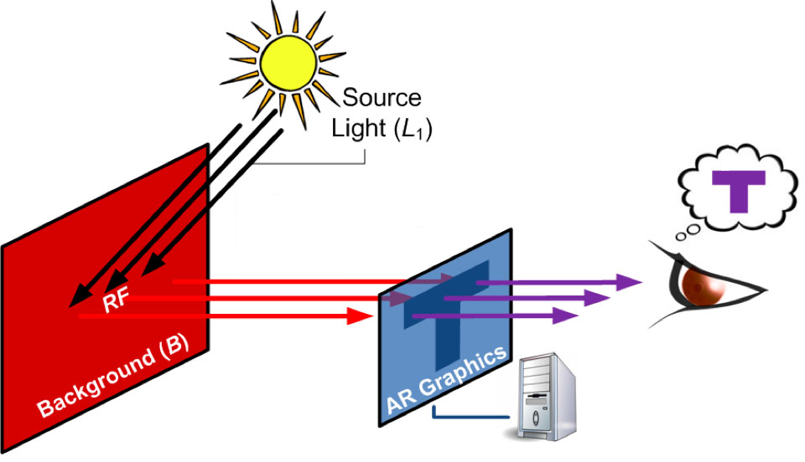
Gabbard et al. 2010. More than meets the eye: An engineering study to empirically examine the blending of real and virtual color spaces , VR 2010
Notes:
A simple example would be digital color blue on a read bg will appear purple
Gabbard et al, in 2010, showed color do change significantly under the influence of different bg

Slide 5
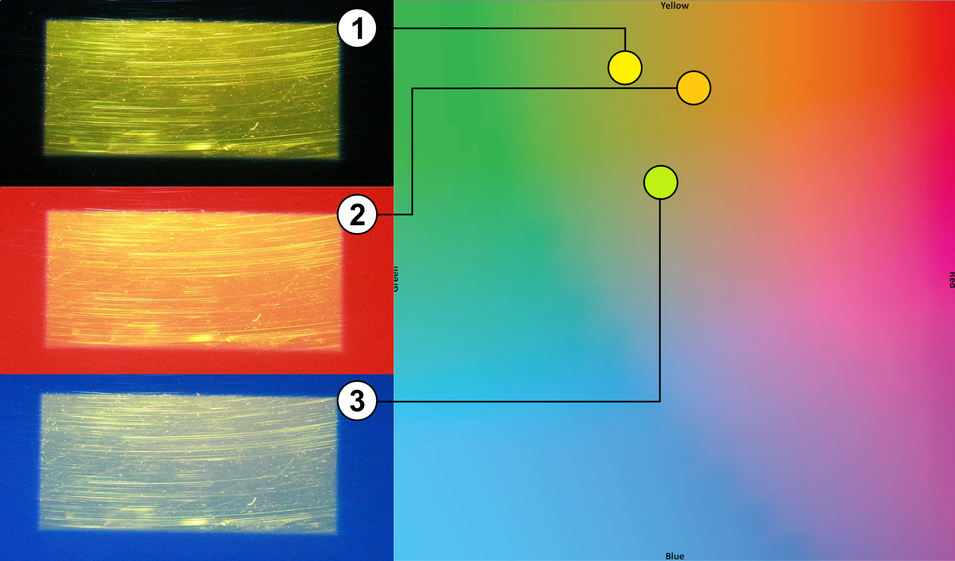
Notes:
This image shows color blending effort on the digital color yellow ,
Here is a OSTD displaying color yellow in 3 different background,
Black background- to the right in the color map you can see yellow being – yellow!
On red background- to the right in the color map you can see yellow being – moved towards red( shows orange)
Blue background-to the right in the color map you can see yellow being – moved towards green

Slide 6
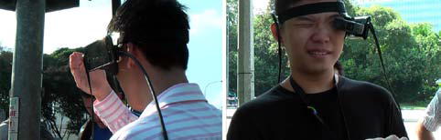
Usability Problem
Kerr et al , Wearable mobile augmented reality: evaluating outdoor
user experience. VRCAI ’11
Notes:
This effect of color Blending has been studied before by various researchers, mostly in the field of Augmented reality.
On usability issues and human perception
One such Eg is,
Kerr et al 2011, studies outdoor use of AR system, where they found on heavy influence from the background users used their hand on have a consistent bg to look at the contents !!
This shows that this influence of the background is a significant problem

Slide 7
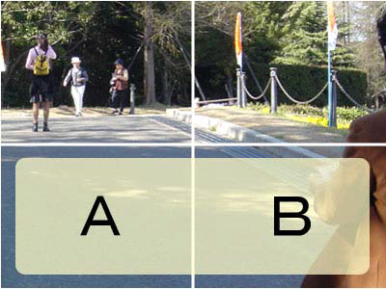
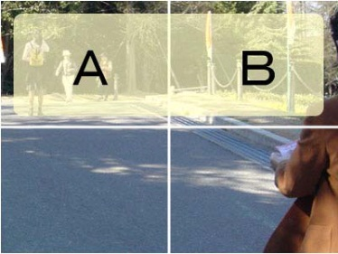
Content Based Solutions
Tanaka et al, An information layout method for an optical see-through head mounted display focusing on the view ability. ISMAR 08
Notes:
There have been other solutions like ,
Tanaka et al. developed a layout system that relocates digital content to the darker areas of the display taking.
This methods might result in constant shift of the digital content for dynamic background.

Slide 8
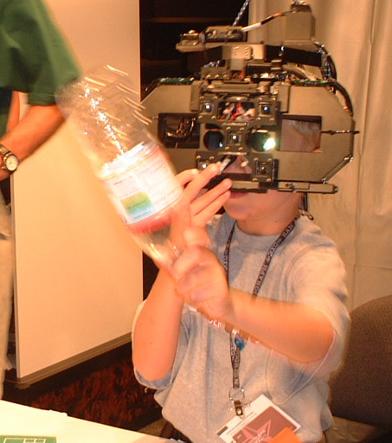
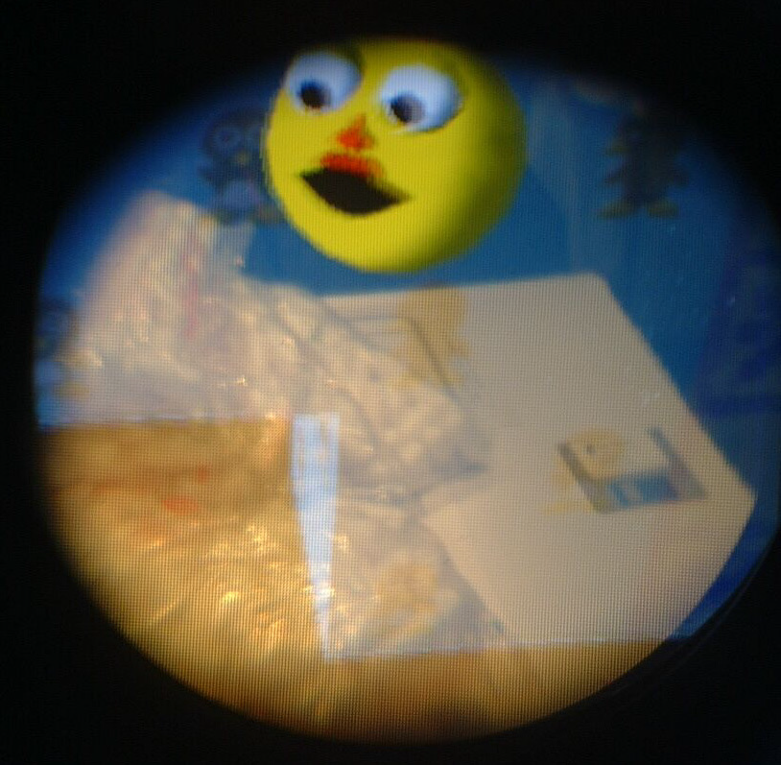
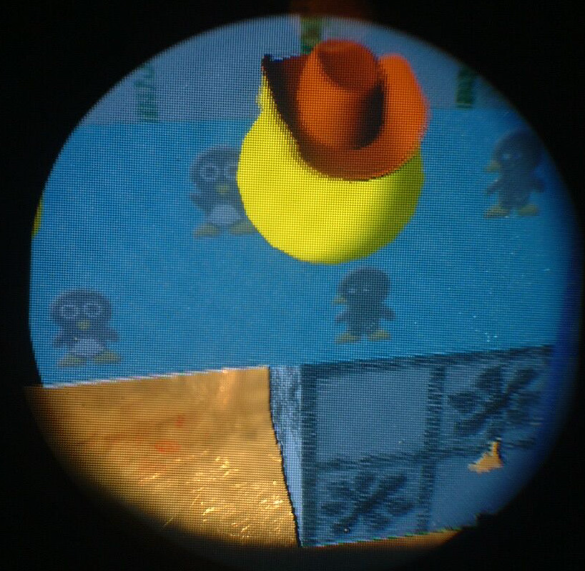
Hardware Based Solution
Kiyokawa et al, An Occlusion-Capable Optical See-through Head Mount Display
for Supporting Co-located Collaboration. ISMAR 2003
Notes:
There have been harware solutions as well
The main approach has been to stop the light coming from the background by adding a exptra piece of hard ware to head-mounted displays with spatial light modulation (SLM) devices
Here you can see in the first image bolors being blend and the second where the digitals colors are very clear
draw backs being the excess hardware and unavailability of the BG.
(clearly they were not going for style)

Slide 9
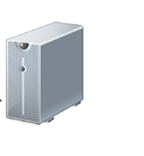
Color Correction
Alternate Color
Background
?
Notes:
Other solutions are called correction.
Where we do not want to keep changing the Here the system finds an alternate color to show,
so that after blending with the background users perceive the color correctly.
For example…
This is a large research area within spatial augmented reality.

Slide 10
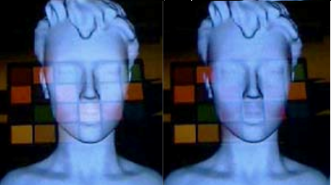
Color Correction in OSTD
Weiland et al, Colorimetric and photometric compensation for optical see-through displays.
Notes:
But in OSTD the only existing work on color corrections is by Weiland et al.’s.
They use foreground color as fed to the system and bg colors as captured
sRGB space was used for color calculations- in which colors accuracy cant be tested
They used Color Subtraction ( Show the second image’s empty spots)

Slide 11
Presentation Flow
A color blending model for OSTD
Display Binned Profile (BP) – main factor
BP-based color correction
Correction analysis of various digital colors
Model – BP Method – Color Correction – Correction Analysis
Notes:
So what is our contributing visa this work ?
A present a new Color blending Model for OSTD
Binned Profile (BP) – To handle Render Distortion
BP Based Color Correction
Design guidelines for OSTD

Slide 12
F(
Bg Color
Background
fmaterial
frender
Blended Color
Digital Color
Model – BP Method – Color Correction – Correction Analysis
Notes:
Every display shows color a bit different , this is more pronounced in OSTD as each display has different display material, light source etc.
As you can see here the color blue shown is slightly changed when its shown on the display. We call this change render distortion
Similar the OSTD display material changes the color of the BG as it shown here with change in hue of bg color red . We call this change as material distortion
We argue in this work the color Belding is a mix of these 2 distorted color than the original colors !!

Slide 13
Blended Color = frender(Digital Color) + fmaterial(Bg Color)
Model – BP Method – Color Correction – Correction Analysis
Notes:
Out color beling modelios based on two functions, render DisTORtion and materail DisTORtion

Slide 14
Blended Color = frender(Digital Color) + fmaterial(Bg Color)
{
Direct Model – Weiland et al.
CAT – Bradford
CAT – Von Kries
CAT – Scaling
Bin Profiles
Model – BP Method – Color Correction – Correction Analysis
Notes:
There are different wasys in which render distoriton be potentially handeled sloved such as
Dm which is synonomys with weiland et al ‘s work ,
Or cat which I will explain as we go
And we present to you a new method called Bp method,
Which we vaLIDATE IT AGAINST THE OTHER METHODS

Slide 15
frender() = Direct Method ( )
return ;
Model – BP Method – Color Correction – Correction Analysis
Notes:
this is synonymous to ro Wiland et al work
WHEN USING DIRECT METHOD,
WHEN fg color is fed to the system, the Dm retuts the same fg to be used , this is synonymous to ro Wiland et al work

Slide 16
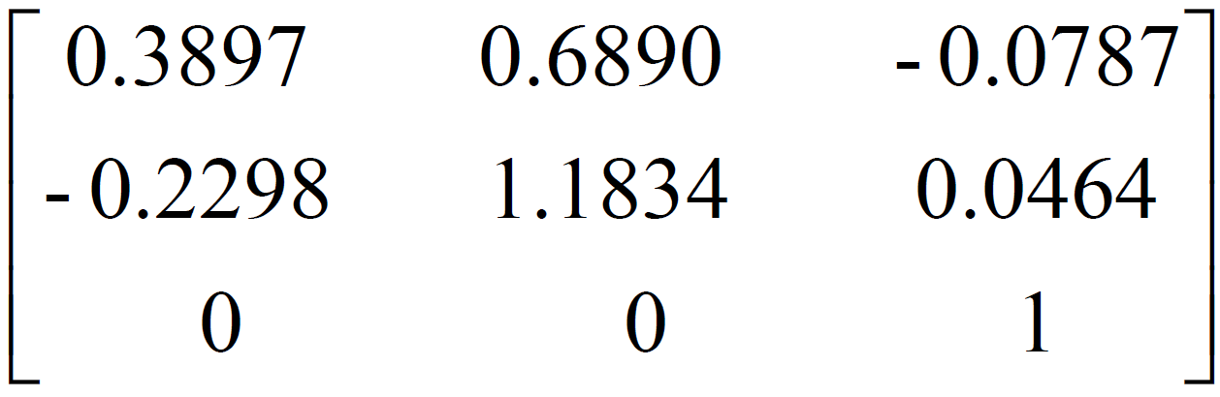
frender() = CAT-Von Kries ( )
* ➔
return ;
Model – BP Method – Color Correction – Correction Analysis
Notes:
CAT are established methods to estimate the colors a display can render based on the brightest white it can emit.
Here for eg lets take con kies
When a system feeds fg color to CAT , the cat transforms the color using a std matrix and returns the transformed color

Slide 17
frender() = Bin Profile method ( )
Display Profile[ ] ➔
return ;
Model – BP Method – Color Correction – Correction Analysis
Notes:
Now we prest to you a new method , BP which is uses the display profile of a given ostd,
When a fg is given to BP method
Exact value of how this fg is shown by the display is returned!!
This BP we believe is a core part of out contibution ,
Now I will explain how to create a BP
We translated the sRGB gamut into the CIE LAB color space and divided it into bins of 5X5X5
This approach guaranties all colors inside a bin are within one Just Noticeable Difference (1 JND ~ 2.3 in Euclidean distance)
we measured how each bin is rendered by each of our three displays on a black background which is shown here for all 3 displays
P37-hundred had a wide color space and close to sRGB when compared to p2200 and TOLED
Create a look up table which is Binned Profile

Slide 18
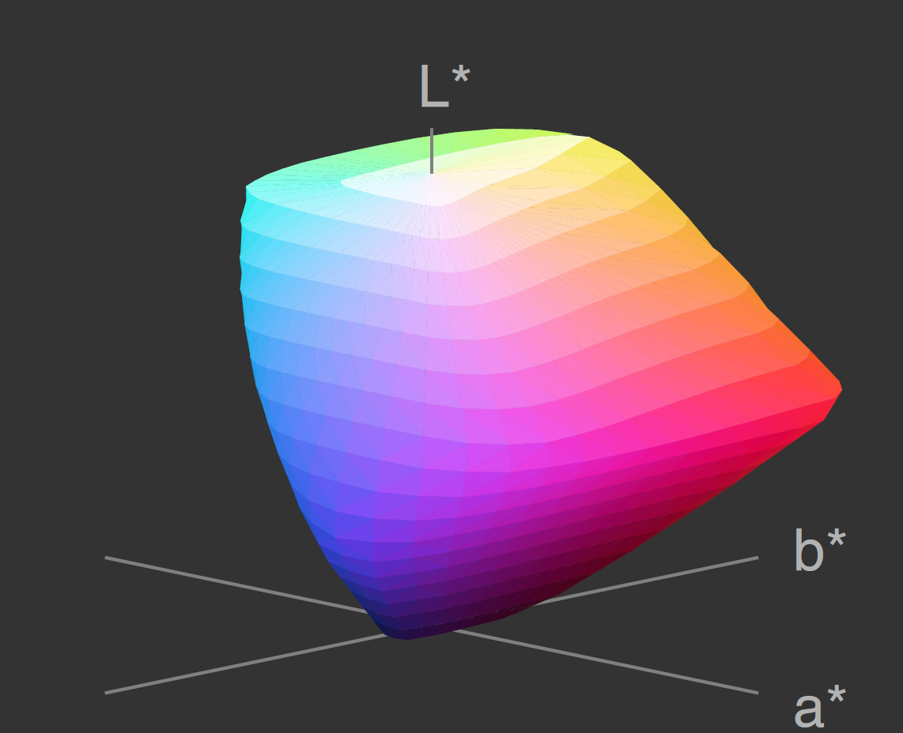
Model – BP Method – Color Correction – Correction Analysis
Notes:
We know rgb colors anount to 16 million continues color space
This image shows that in CIE lab color space which is a uniform color space

Slide 19
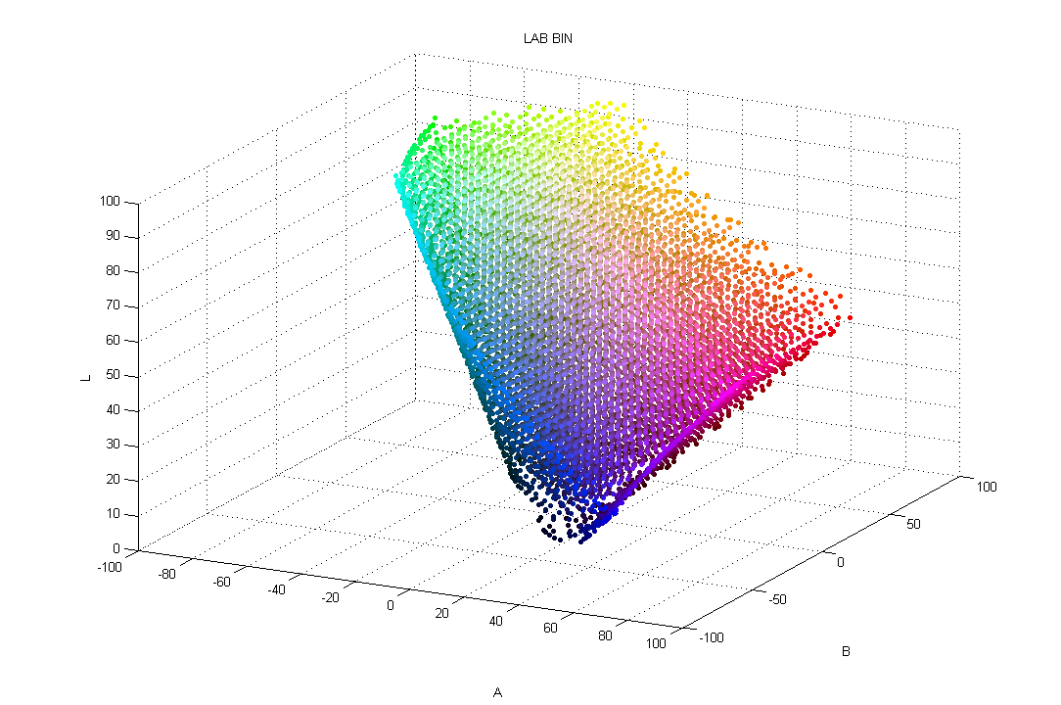
Just Noticeable Difference :
1 JND ~ 2.3 in Euclidean distance
Heer et al, Color naming models for color selection, image editing and palette design.
CHI 12.
Model – BP Method – Color Correction – Correction Analysis
Notes:
We divide this color space into finte numbre of 8376 colors , we do this by binning them to one represeationve color for ever 5X5X5 bins in LAB space
This is based on her et al work where they try to name to colors
The bueaty of this approch is it guaranties all colors inside a bin are within one Just Noticeable Difference ( where1 JND ~ 2.3 in Euclidean distance)

Slide 20
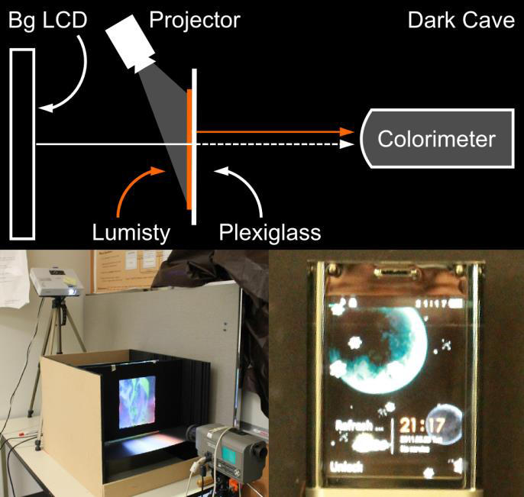
Notes:
Then we displayed these colors on two projection based ostd & 1 toled and measured it using a colorimeter

Slide 21
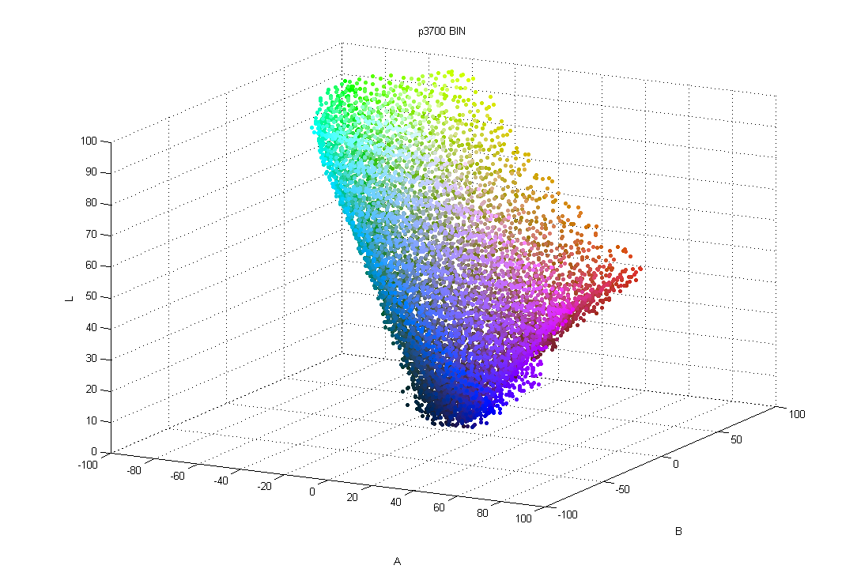
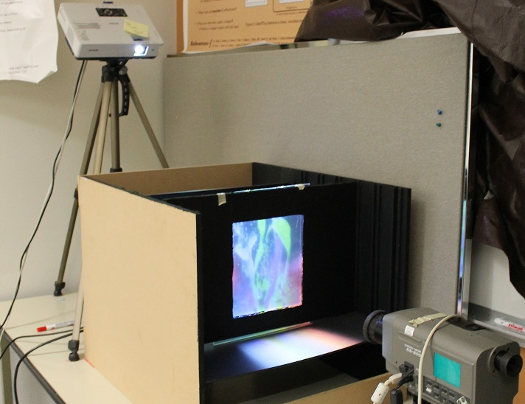
Model – BP Method – Color Correction – Correction Analysis
Notes:
On measuring the one of the projection based display gave a display profile which looks almost similar to srgb

Slide 22
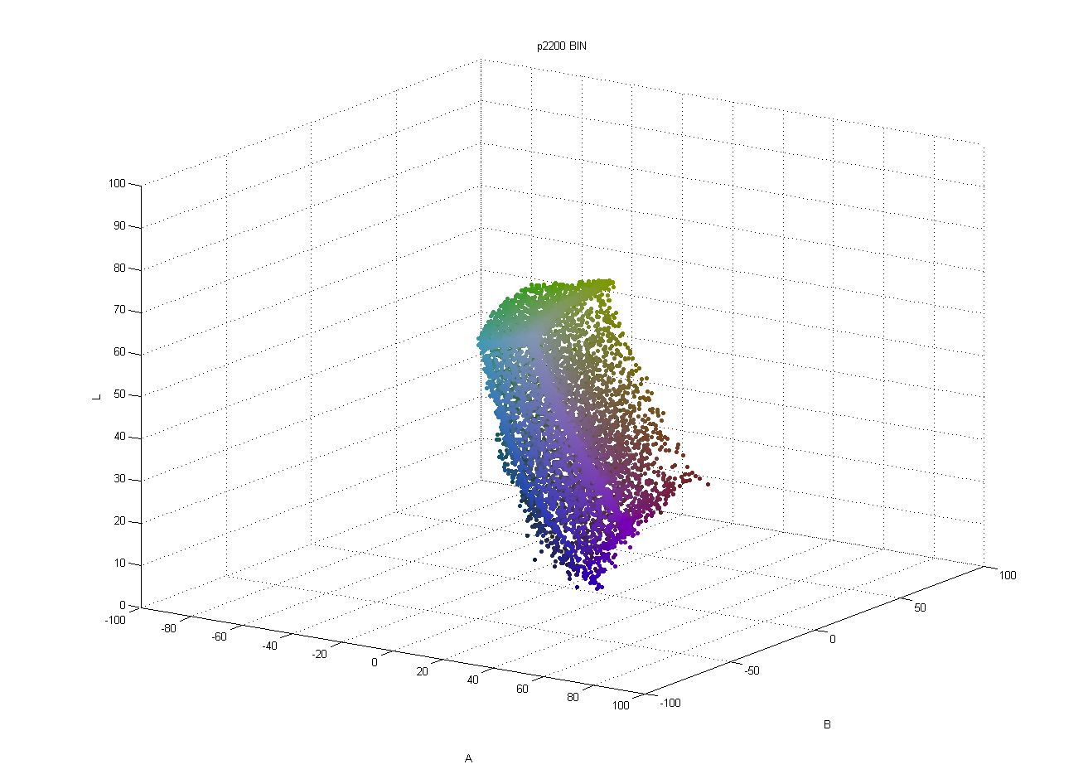
Model – BP Method – Color Correction – Correction Analysis
Notes:
On measuring the one of the projection based display gave a display profile which looks almost similar to srgb

Slide 23
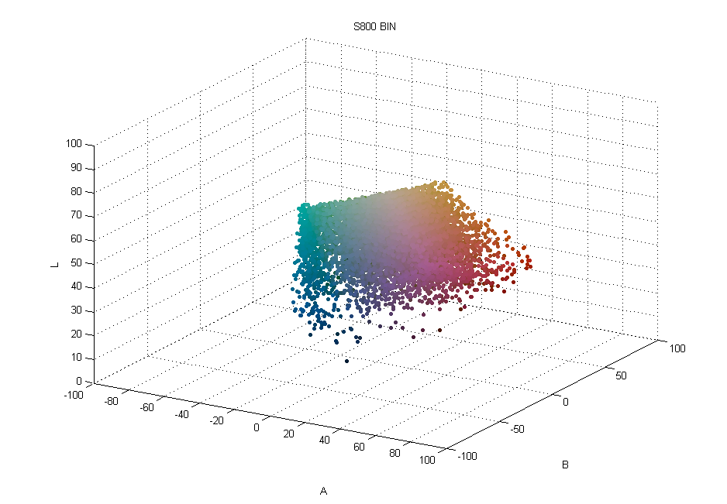
Model – BP Method – Color Correction – Correction Analysis
Notes:
While Toled gave a display profile which look some what reduced

Slide 24
Model – BP Method – Color Correction – Correction Analysis
Notes:
We now had a one to one mappingbetween acolor and how its shown on a display

Slide 25
Model – BP Method – Color Correction – Correction Analysis
Notes:
Forr example a color blue which is

Slide 26
Blended Color = frender(Digital Color) + fmaterial(Bg Color)
{
Direct Model – Weiland et al.
CAT – Bradford
CAT – Von Kies
CAT – Scaling
Bin Profiles
Model – BP Method – Color Correction – Correction Analysis
Notes:
Till now I have shown you various method to account for frender function , we handedled fmaterial through caputing the bg through the screen using a colorimtere
Validation the accuracy of the different frender functions by measuring how accurately they predict color blending

Slide 27
Prediction Error
Background
Prediction
Distance in LAB = Error
Measured
Model – BP Method – Color Correction – Correction Analysis
Notes:
We used 838 fg colors on each of our 23 bg colors, measured the blend.
We find the error in our prediction by finding Euclidean distance in lab space between the predicted value and the measured blend

Slide 28
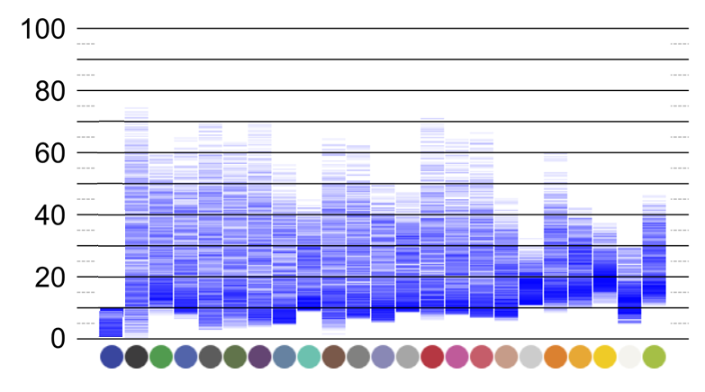
Results Visualization
Prediction Error – Distance in LAB
Bg colors used
Model – BP Method – Color Correction – Correction Analysis
Notes:
This visualization shows prediction error value
across 23 bg macbeth chart colors for bg whhich is shown in x axis
And eq distance in y
First 2 boxes shows: there is a large spread in error for those backgrounds
Box3: shows that for this particular bg , the prediction error was low ,
Ideally this is how all bg should look for a low error rates
Box4: shows the error spread is concentrated between 10 – 40
the hue of blue indicates more value fell in that region .
Error rate at the bottom near 0, represent prediction with low error rate

Slide 29
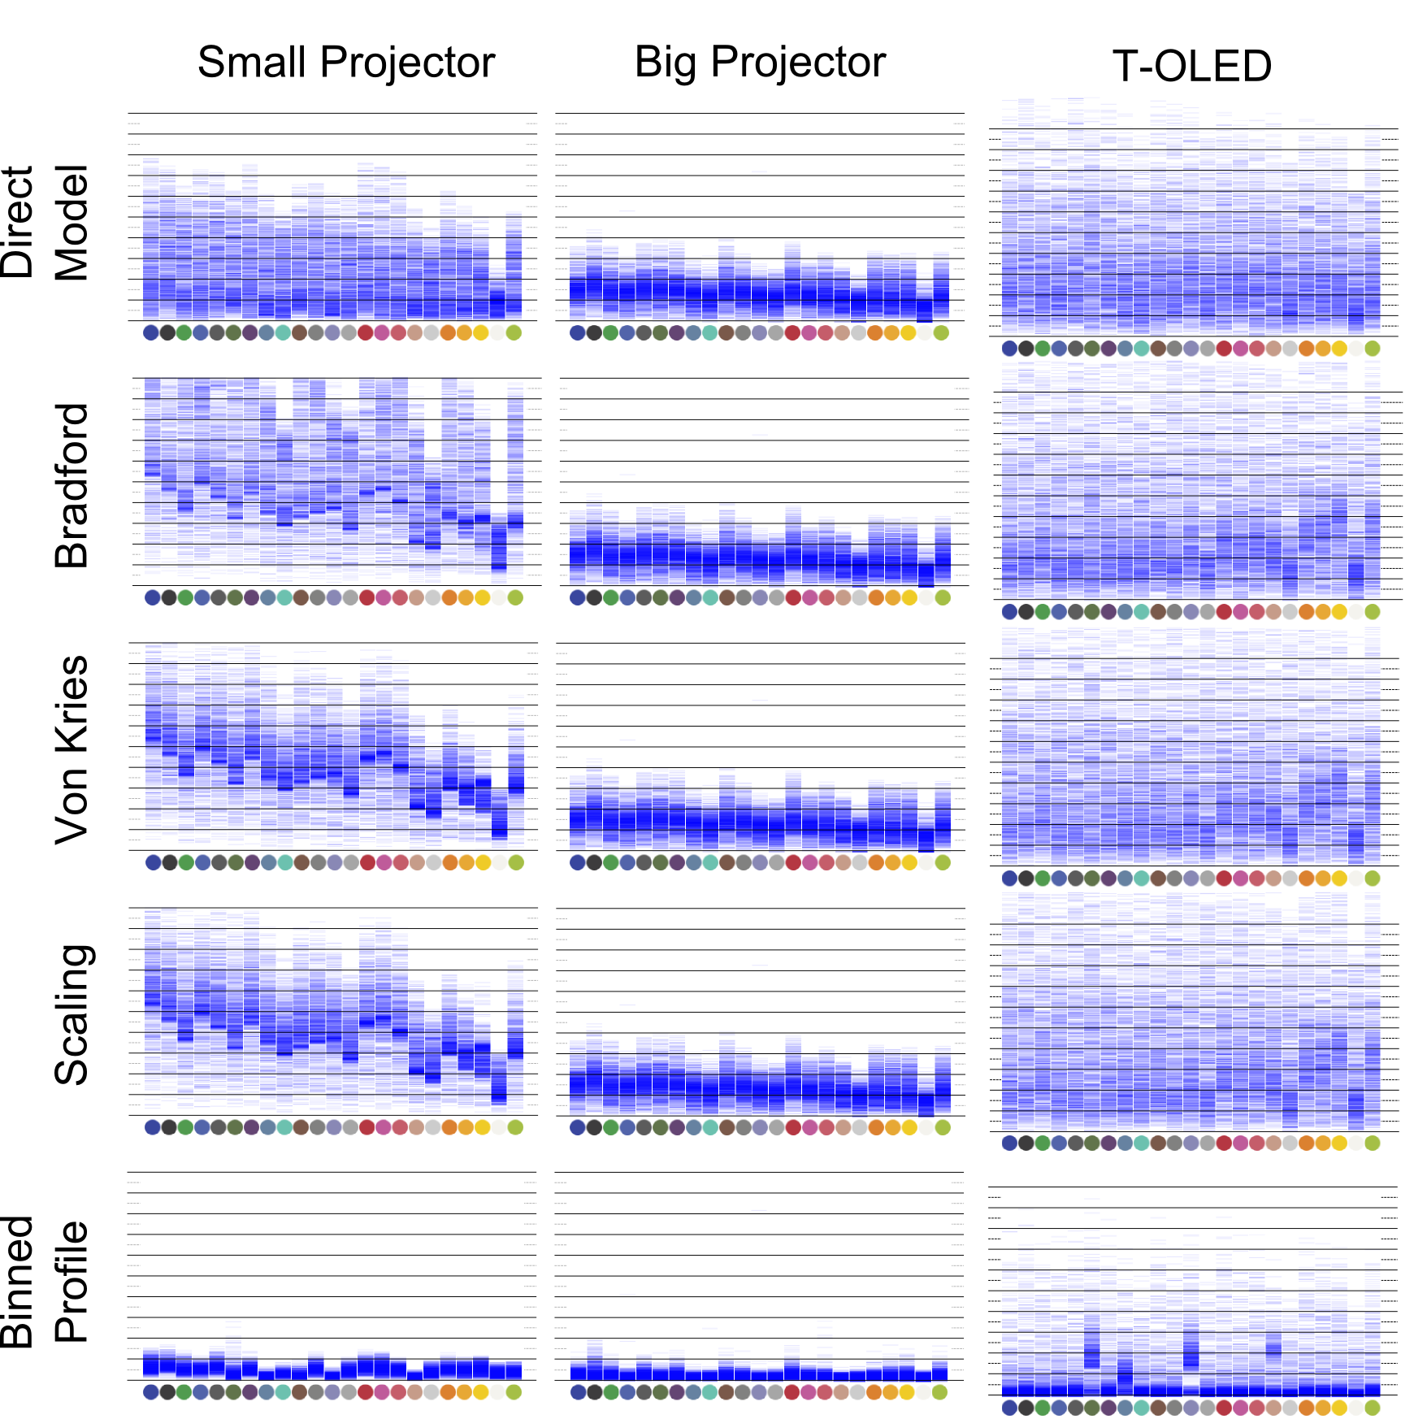
Model – BP Method – Color Correction – Correction Analysis
Notes:
This visualization was used to compare the 5 models we had, over 3 displays in 2 different bg config
Bp In all cases was found to be the most accurate in predicting the blend
This validates the use of BP to predict how colors blend

Slide 30
Color Correction
Background
?
Target Color
BP Correction Algorithm
?
Digital
Color
Model – BP Method – Color Correction – Correction Analysis
Notes:
When color yellow is shown in red bg , it moves towards orange ,
Color correction needs to find a alternate color which on blending with bg will give yellow
We use BP correction algorithm to pick this alternate error

Slide 31
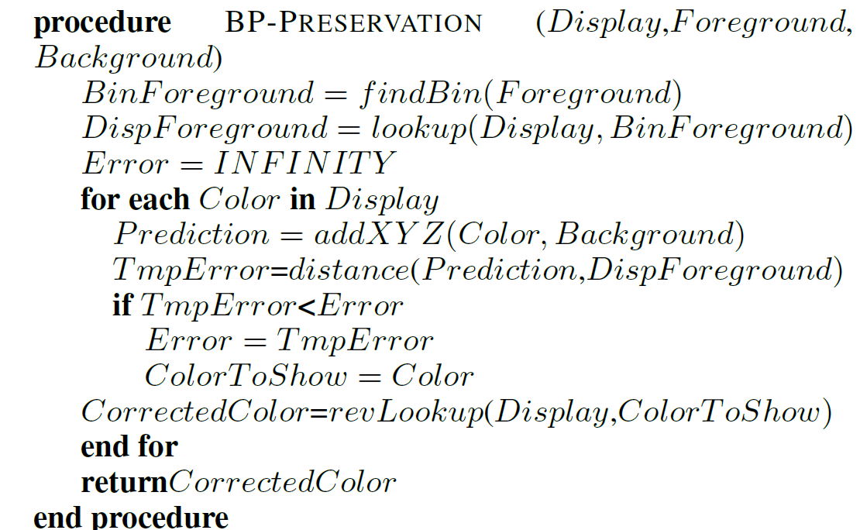
procedure BP-PRESERVATION (Display,Foreground,
Background)
BinF oreground = findBin(Foreground)
DispF oreground = lookup(Display;BinF oreground)
Error = INFINITY
for each Color in Display
Prediction = addXY Z(Color;Background)
TmpError=distance(Prediction,DispForeground)
if TmpError<Error
Error = TmpError
ColorToShow = Color
CorrectedColor=revLookup(Display,ColorToShow)
end for
returnCorrectedColor
end procedure
Model – BP Method – Color Correction – Correction Analysis

Slide 32
Target =
… 8376 times
Color to Show =
Model – BP Method – Color Correction – Correction Analysis

Slide 33
BP Color Correction
Background
?
Target Color
Distance in LAB = Error
Measured
BP Correction Algorithm
?
Digital
Color
Model – BP Method – Color Correction – Correction Analysis
Notes:
This color is then applied on the screen
Which happens to be green
The correction error is calculated by finding the distance between the color we desire and the actual blend after correction

Slide 34
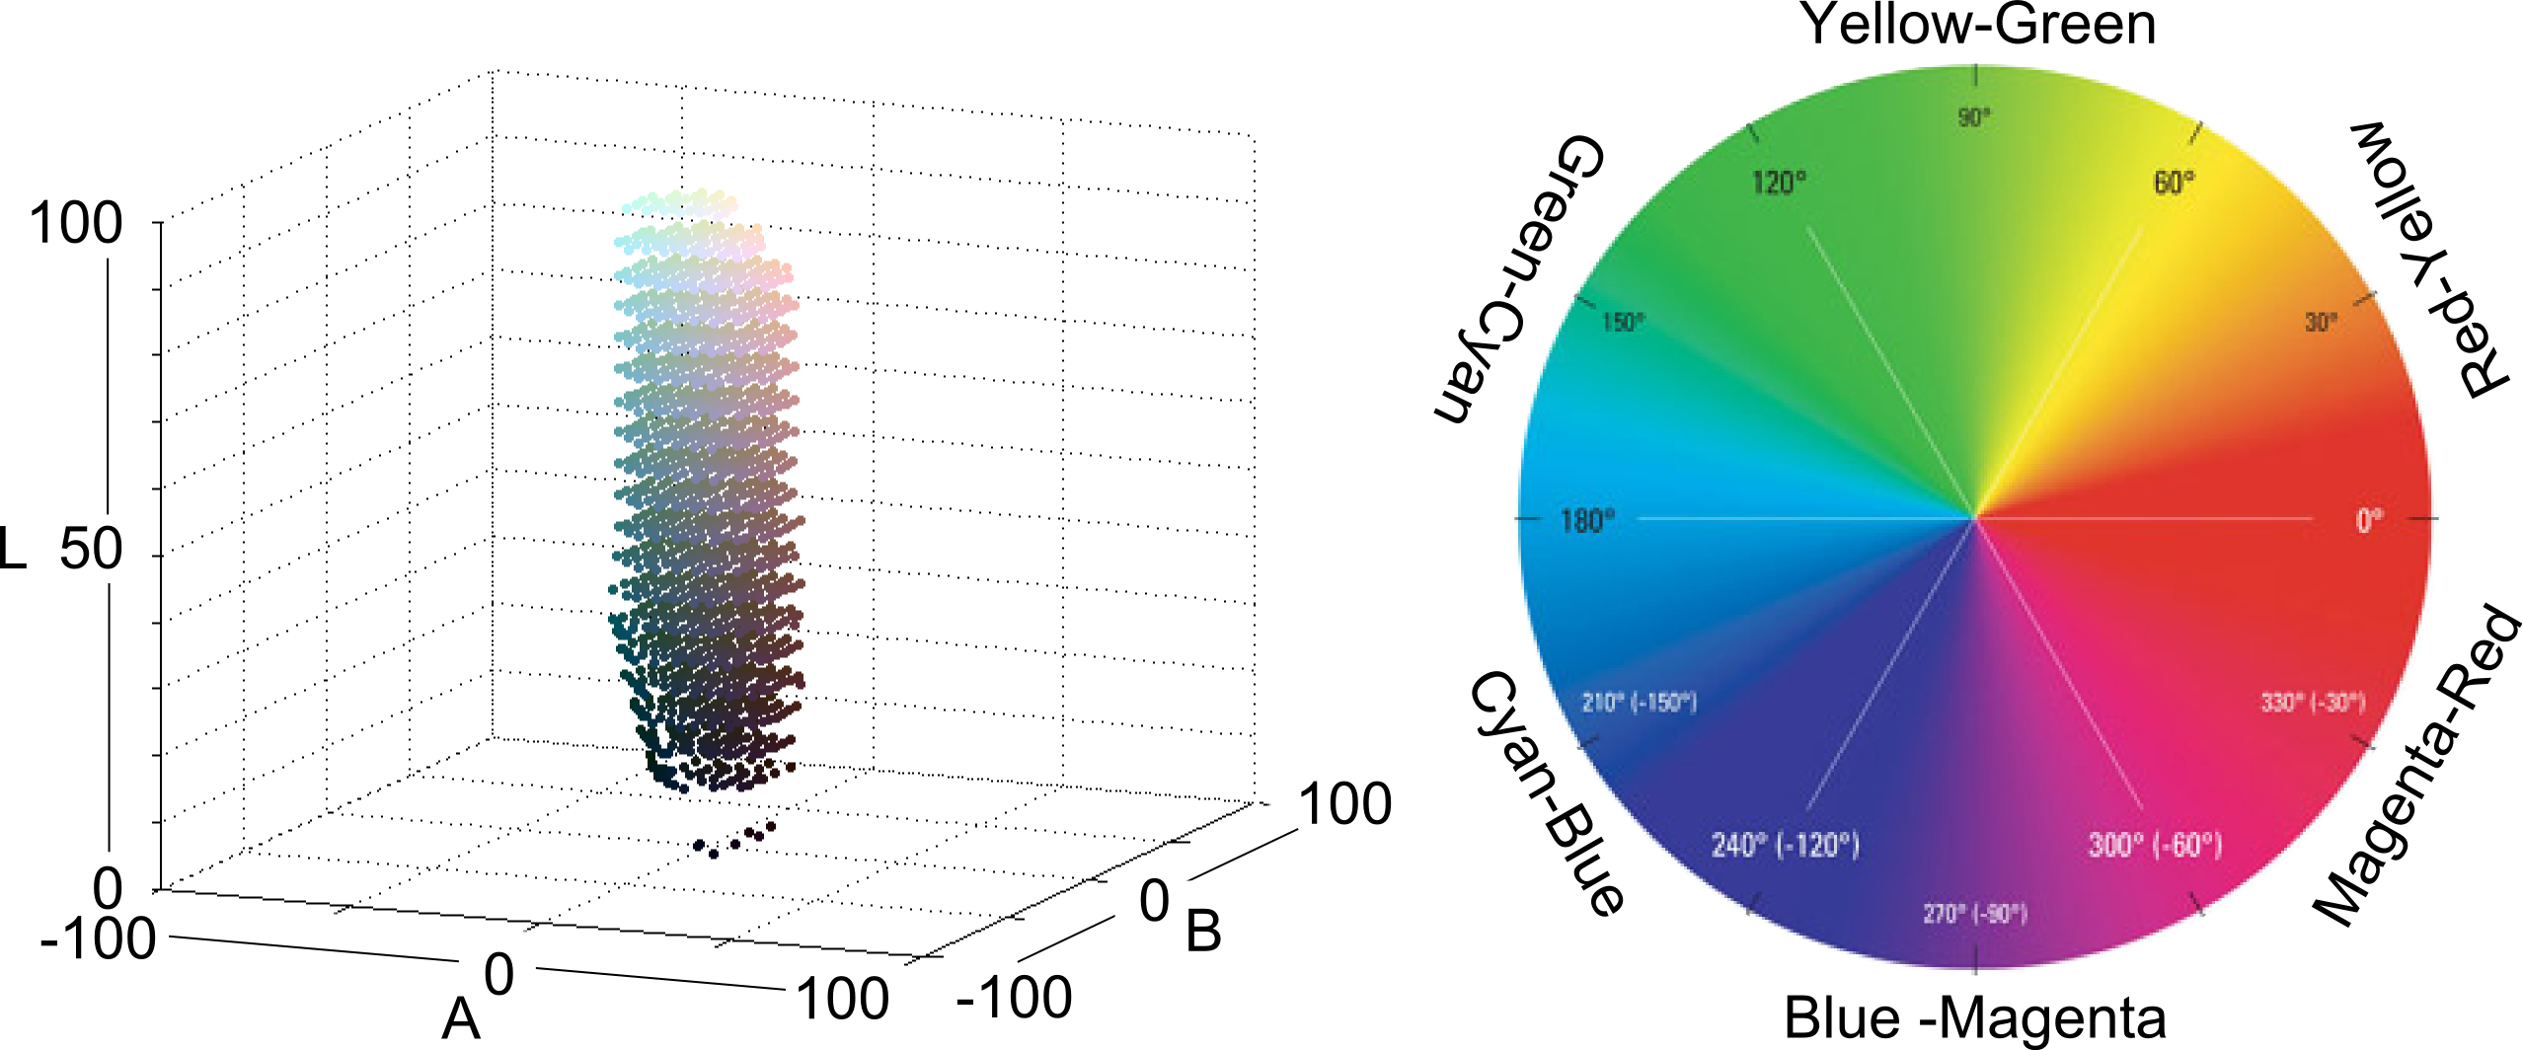
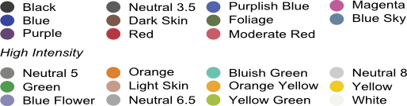
Color Analysis
10 groups:
Dark colors(L < 50), light colors (L >= 50)
Dark and light neutrals
6 chromatic regions
Low Intensity
Model – BP Method – Color Correction – Correction Analysis
Notes:
10 groups:
Dark colors(L < 50), light colors (L >= 50)
Dark and light neutrals
6 chromatic regions
Same way we divided
Bg into low intesity and high intensity bg,

Slide 35
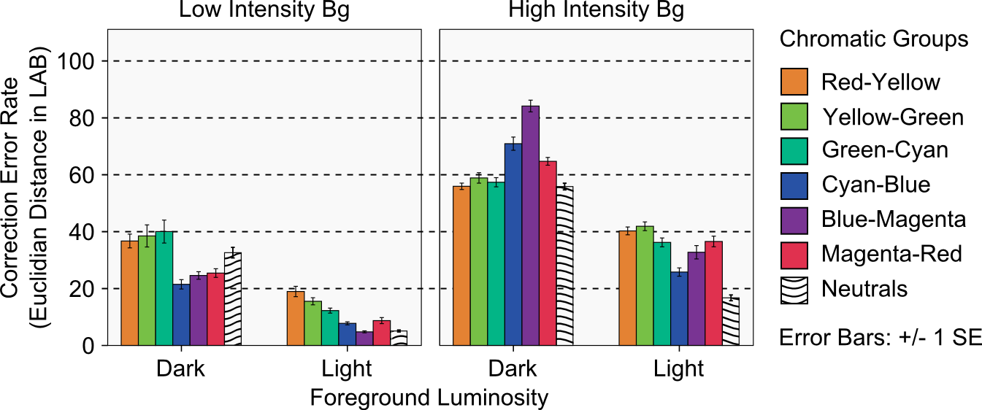
Quantitative Analysis
Kruskal-Wallis test was done, Sig <0.001
Model – BP Method – Color Correction – Correction Analysis
Notes:
We generally found neutrals to have low error rate, other than that we found light colors in cyan blue region preforming consistently better among all the other color regions across the bg.
All colors in light region performed better on dark bg
Dark colors in high intensity bg performed the worst !!

Slide 36
Design Implications
Use light neutral colors for information that needs to be preserved best
If more hue is needed, designers can use light colors in the Cyan-Blue region
Dark colors should be avoided for text and color-encoded information
Usage of color themes based on the background will be wise
Model – BP Method – Color Correction – Correction Analysis
Notes:
A UI designer for OSTD show keep following points in mind
Use Light neutral colors for information that needs to be preserved best (text , icons etc)
If more hue is needed, designers can use light colors in the Cyan-Blue region (alerts)
Dark colors should be avoided for text and color-encoded information
Usage of color themes based on the background will be wise
Have in mind there we are not recommending these to preserve contrast we are more concern about color

Slide 37
Contributions
A color blending model for OSTD
Display Binned Profile (BP) – main factor
BP-based color correction
Correction analysis of various digital colors
Notes:
So what is our contributing visa this work ?
A present a new Color blending Model for OSTD
Binned Profile (BP) – To handle Render Distortion
BP Based Color Correction
Design guidelines for OSTD

Slide 38
Future Work
Notes:
We are currently working on a algorithm which is not brute force.
Also working to implement this on a HMD

Slide 39


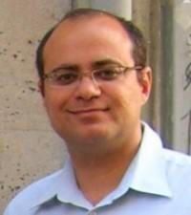

Acknowledgements
Dr. Juan David Hincapié-Ramos
Dr. Pourang Irani
Dr. David R. Flatla
Special thanks to Jango Guo
NSERC for funding and people at HCI lab In university of Manitoba

Slide 40

Thank you, Questions?
Presented by,
Srikanth Kirshnamachari Sridharan

Slide 41
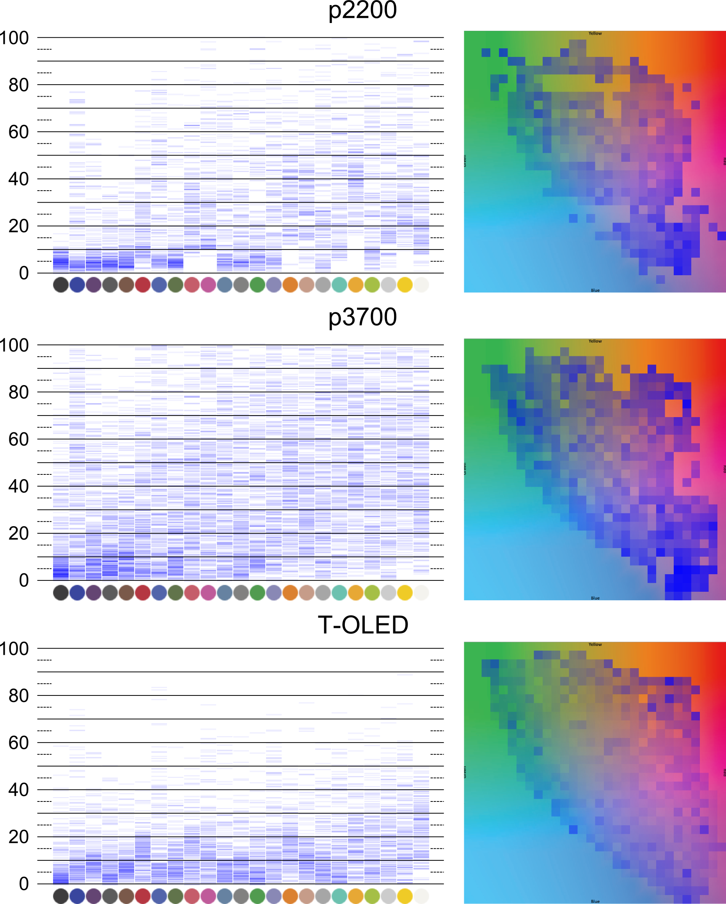
Result
Model/BP Method/Color Correction/Correction Analysis
Notes:
We created correction heat maps for all 3 displays,
The heat map shows generally colors for p22-hundered and TOLED were better corrected than the p3700
This is due the both these displays have limited color profile, so the distqance between a color to shown in bin and how it measured fg will always be small.
We also found a trend in fg color always got corrected better for low intensity bg , with the correction error increasing with the intensity of the bg.
We took the p3700 and studied it further has it had wider range colors , which are typlically needed for rich multimedia contests

Slide 42
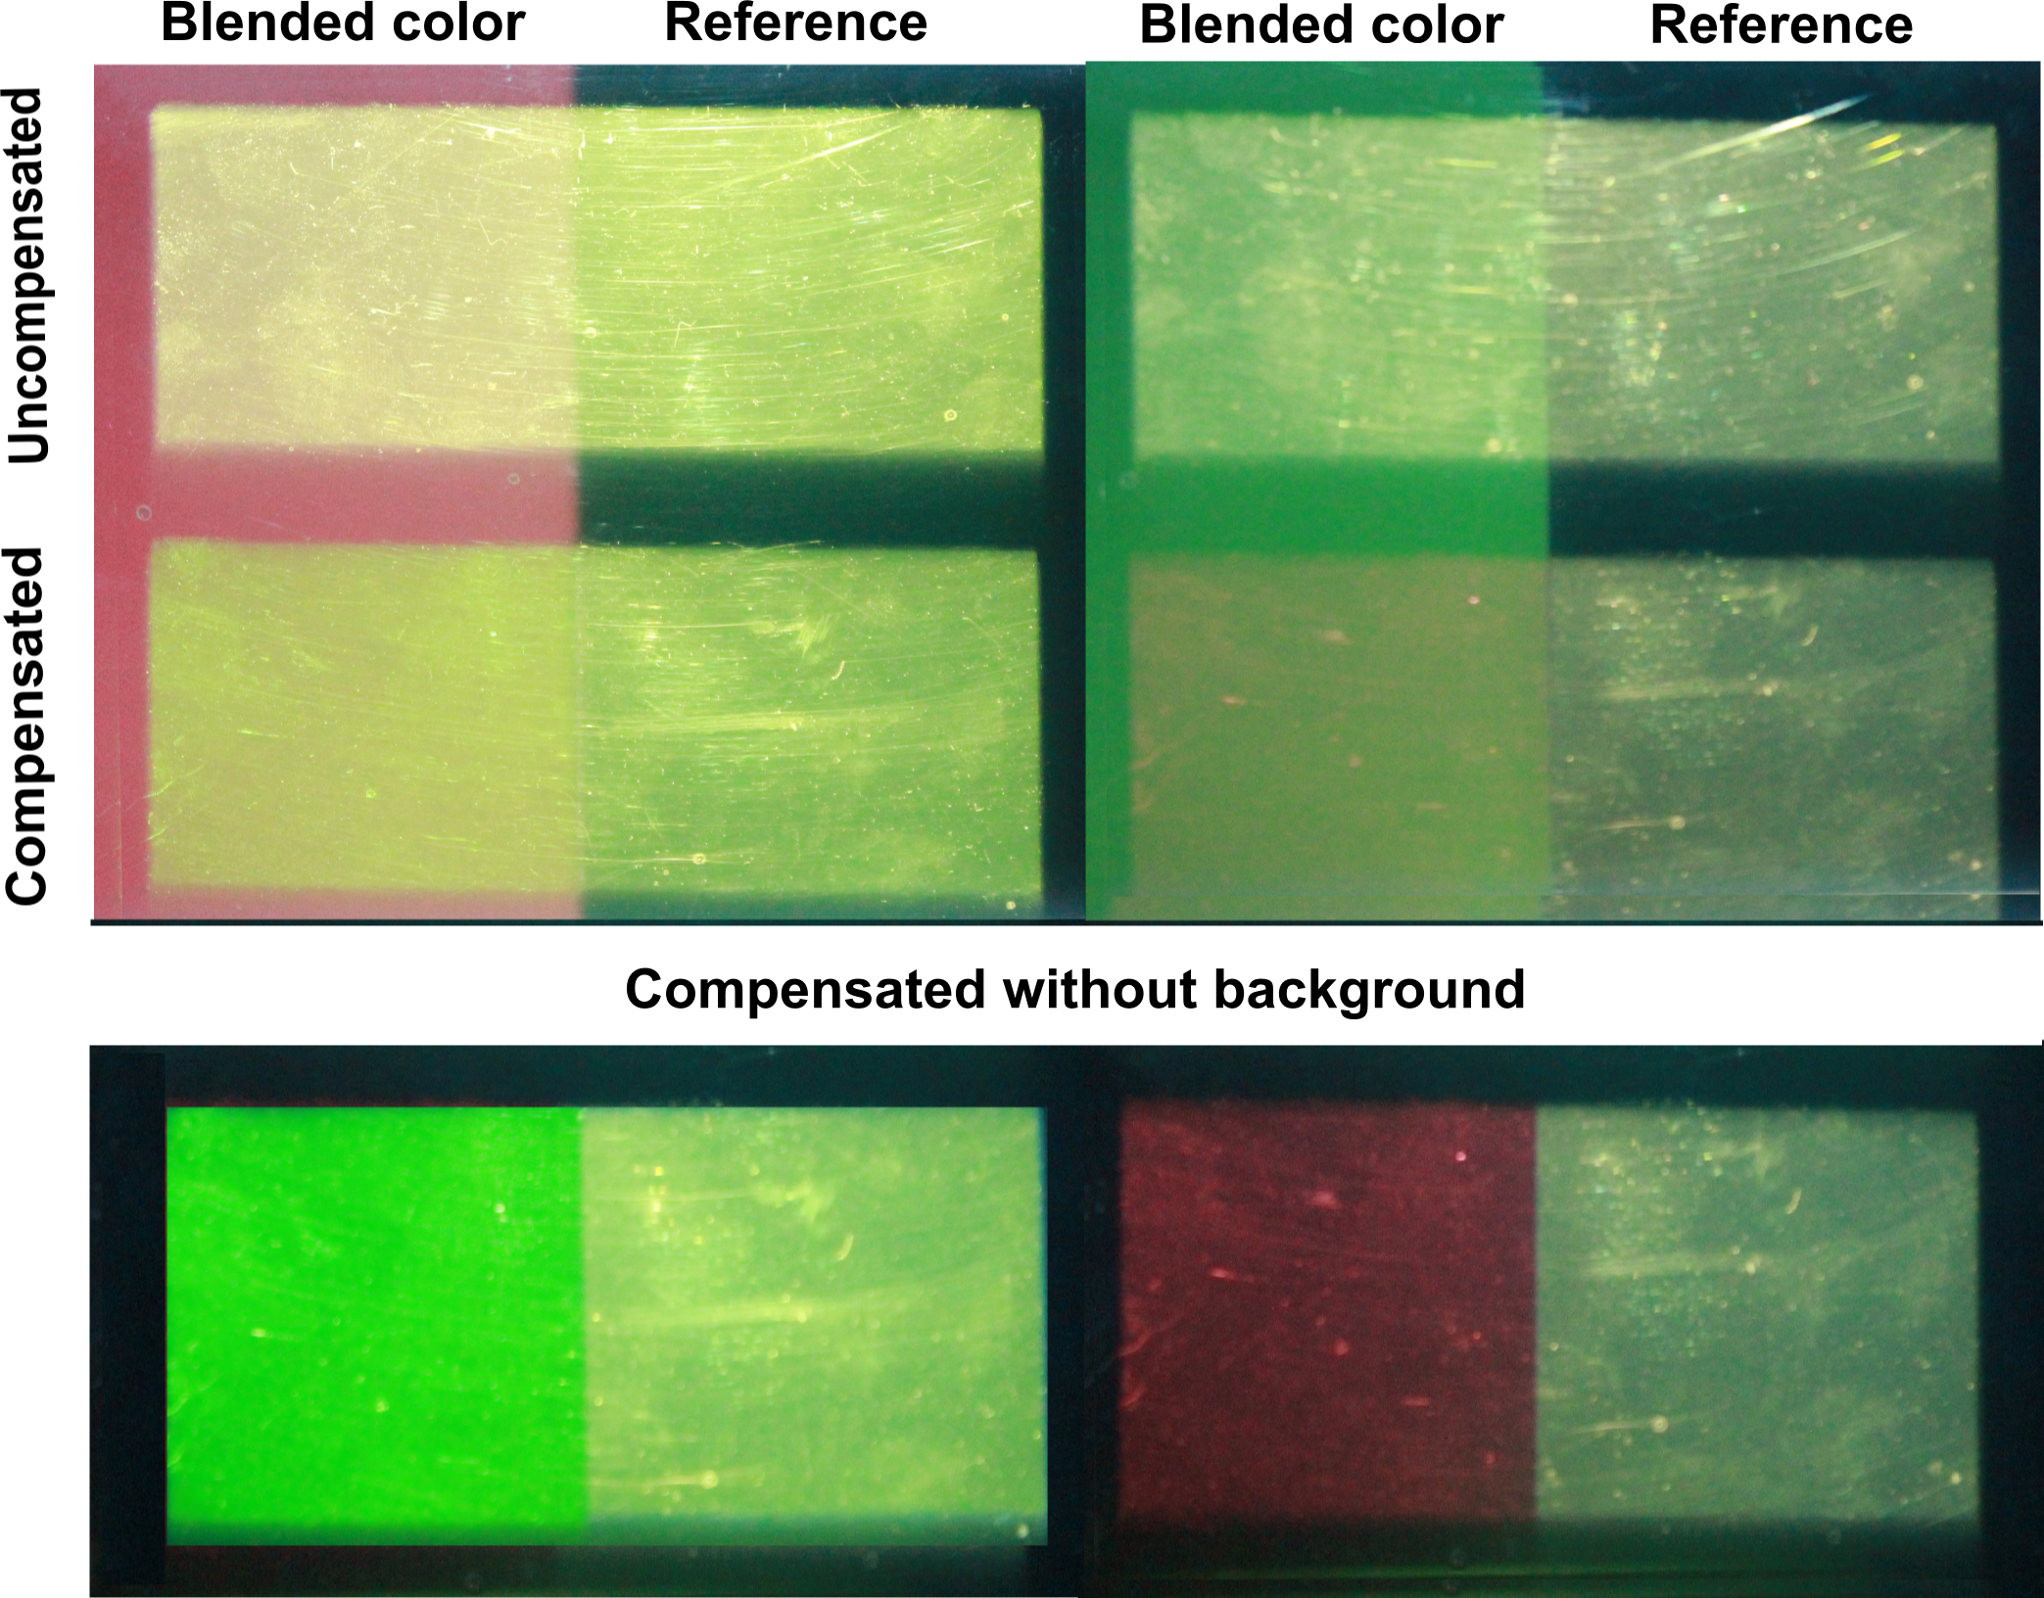
Notes:
Example of the system working

Slide 43
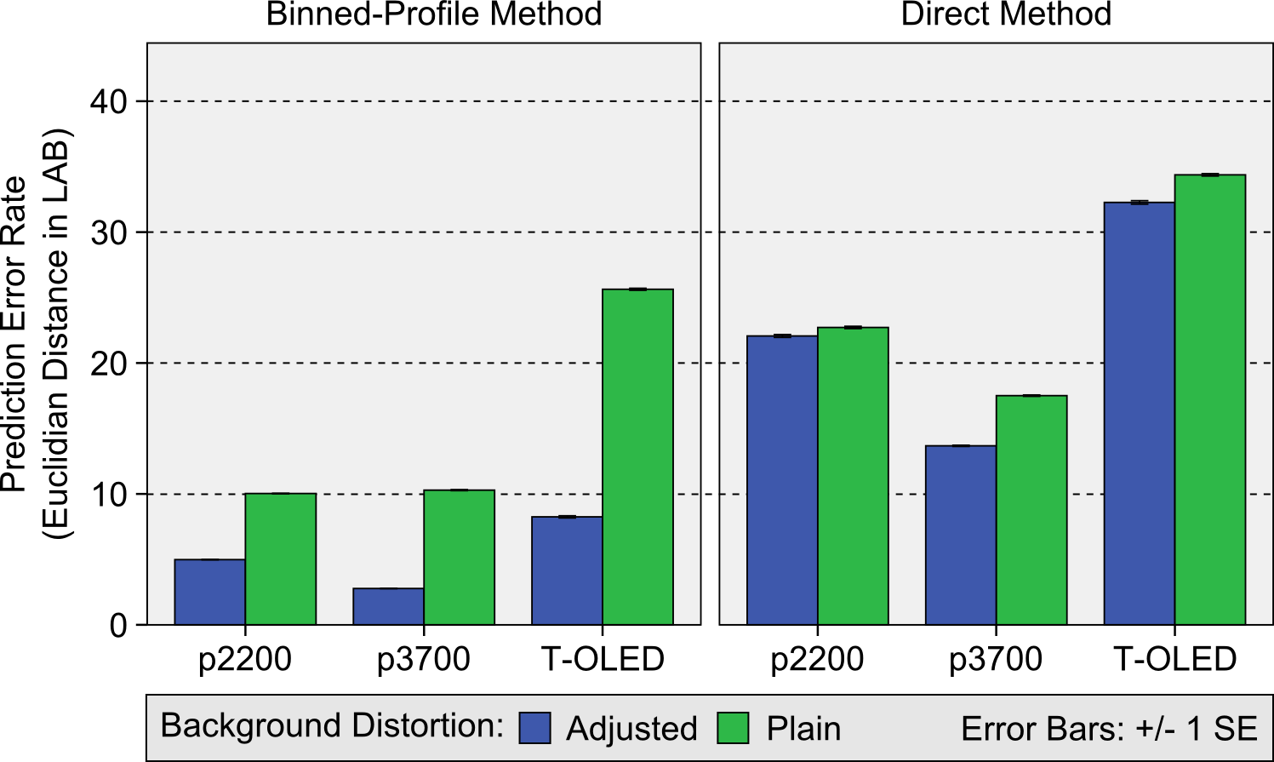
Quantitative analysis
Kruskal-Wallis test was done, Sig <0.001
Notes:
We decided to do quantitative analysis for bp and direct model.
Here green bars rep bg in plain config, blue bars rep bg in adjusted config
Graph shown there is a fall in green pars perdition error between bp and direct model for all 3 displays.
This shows accounting for render distortion with the help of bp decreases the prediction error.
While both the distortions were accounted for the prediction accuracy increased as shown in the graph comparison between plain and adjusted config using bp on all 3 displays.
However addressing only the material distortion , does little change to the error rate
this result shows the render distortion constitutes the core of color blening in OSTD

Slide 44
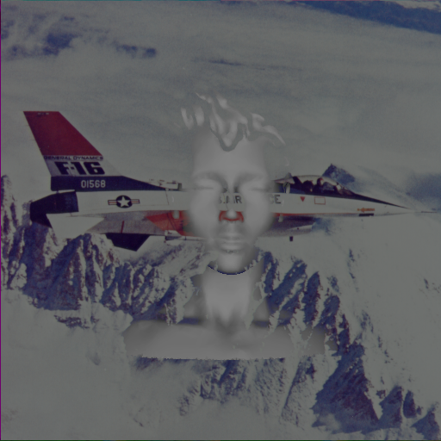
Notes:
JND is the Euclidian distance between 2 given color in a color space with in which the colors appear same to humans.
In XYZ space it varies with each color, but in uniform spaces like LAB and LUV its constant number ( 2.5 in lab).

Slide 45
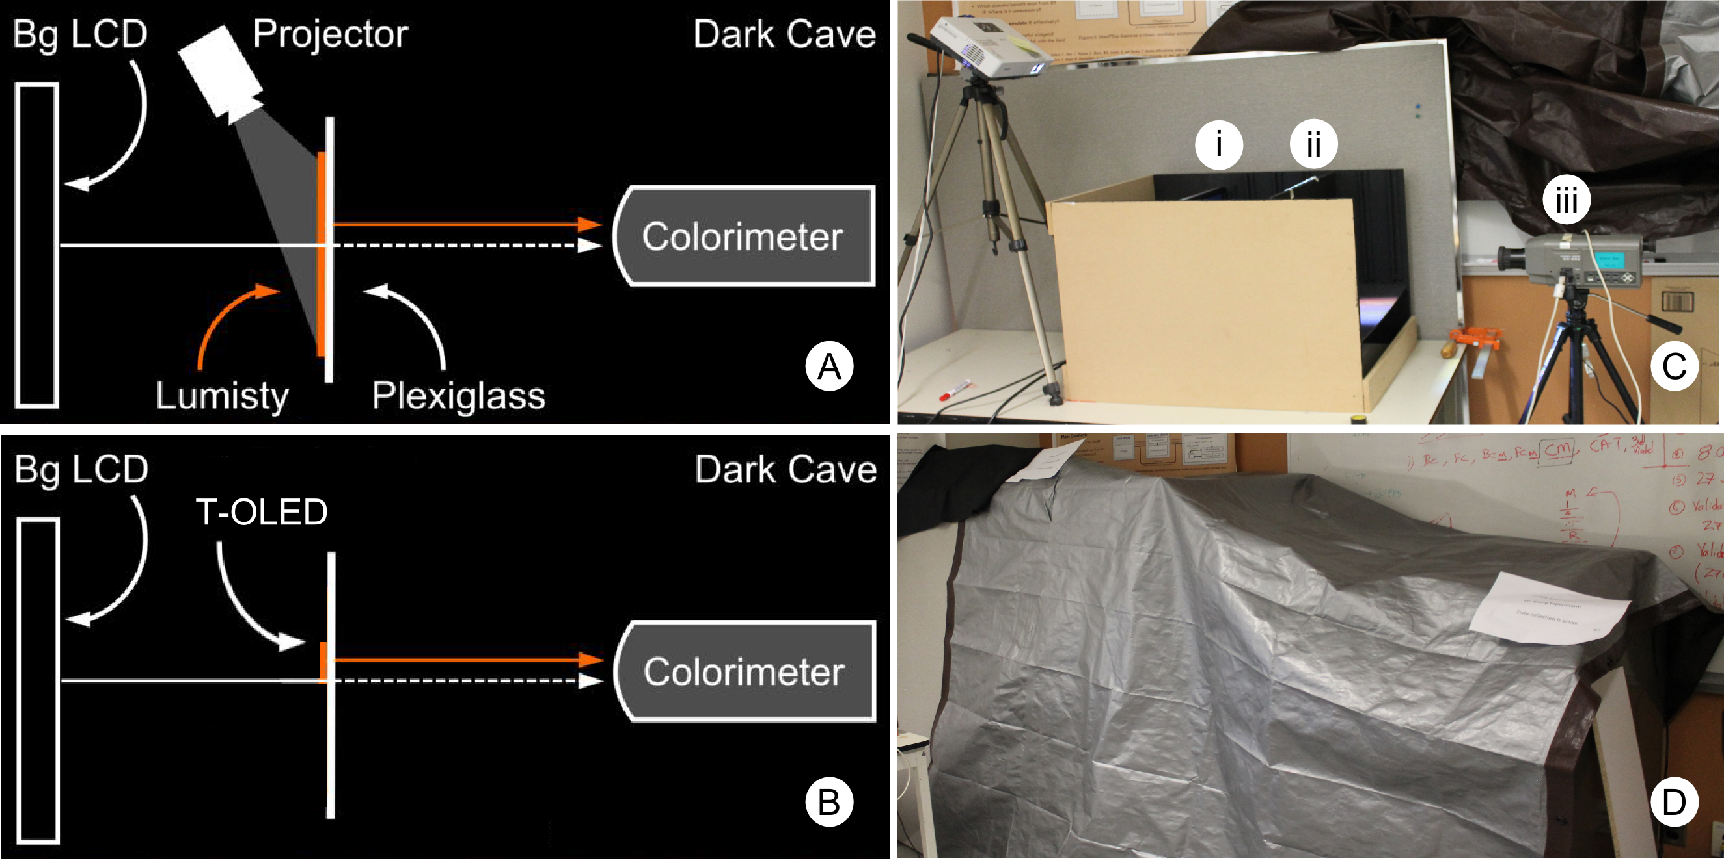
Setup
Notes:
Image on the left shows how the set up was for both projection based and TOLED
Image on the right © shows how the actual setup was.
And image d shows the out light controlled environment
We used cs200 colorimeter to measure the color values.

Slide 46
Notes:
Cat fg colors

Slide 47
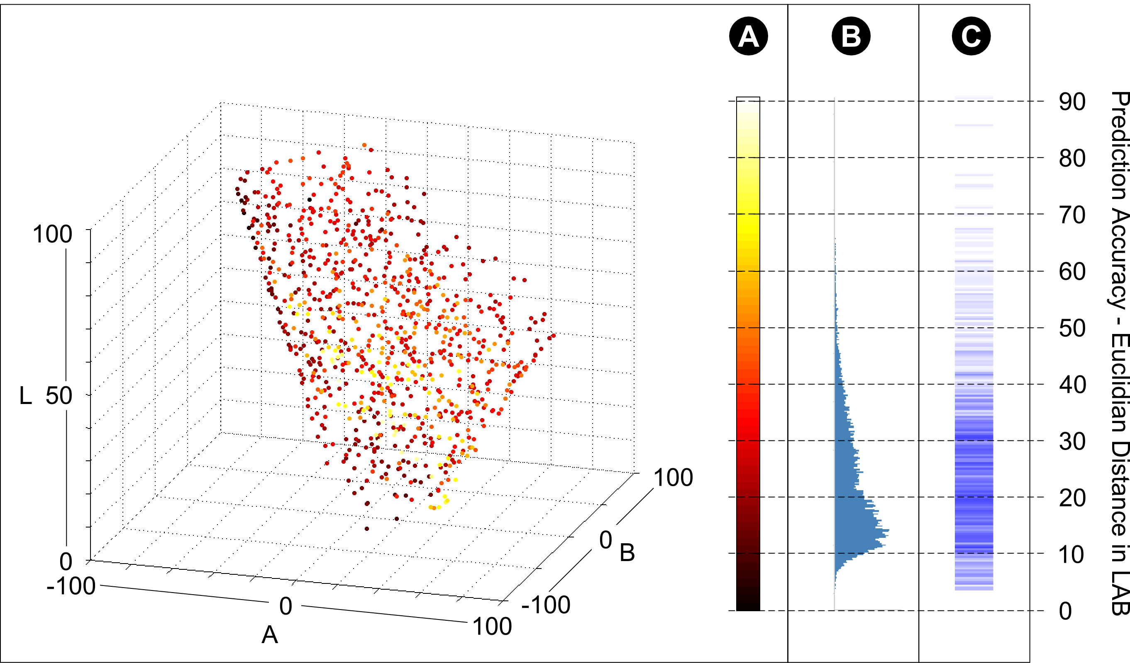
Result
Notes:
Prediction result viz

Slide 48
Direct Method prediction
Bg Color
Background
Digital Color
Prediction
?
?
Digital Color
Model/BP Method/Color Correction/Correction Analysis
Notes:
Direct Method:
Synonymous to Weiland et al work
The digital color is simply added to the background
It ignores both render and material distortion

Slide 49
CAT Method prediction
CAT
Transformation
Bg Color
Background
Prediction
?
?
Digital Color
Model/BP Method/Color Correction/Correction Analysis
Notes:
CAT
CAT are established methods to estimate the colors a display can render based on the brightest white it can emit. They are based on matirc converstions
In other words we hoped that they could potentially handle render distortion

